Slide 1
Light Scattering: What you can and cannot get from it?
Rafael Cueto
Polymer Analysis Lab
Physical Chemistry Seminar
10-13-2015

Slide 2
OVERVIEW
Summary and description of Light Scattering
PAL Capabilities
Dynamic Light Scattering
Static Light Scattering

Slide 3
Static Light Scattering
Measures Total Intensity of Scattered Light
(Mass(M), Size (r_{g}), Second Virial Coefficient (A₂)
Dynamic Light Scattering
Measures Fluctuation Changes on The Intensity of the Scattered light
(Diffusion Constant (D_{T}), Size, R_{h}, Polydispersity Index)

Slide 4
Common Radius Definitions
Hydrodynamic Radius (RH)
Radius of Rotation (RR)
Mass Radius (RM)
Radius of Gyration (Rg)
Comparison of hydrodynamic radius (RH) to other radii for lysozyme (From Malvern)
Notes:
Hydrodynamic Radius (RH): The radius of a hard sphere that diffuses at the same rate as the protein. Includes hydration and shape effects.
Other Common Radius Definitions
Radius of Rotation (RR): The radius of a sphere defined by rotating the protein about the center of mass.
Mass Radius (RM): The radius of a hard sphere of the same mass and density of the protein.
Radius of Gyration (Rg): The mass weighted average distance from the center of mass to every atom in the protein

Slide 5
PAL Light Scattering Capabilities
Zetasizer Nano ZS
Wyatt MALS Detectors (Heleos, EOS, Dawn)
  On Line (GPC, AF4)
  Micro Batch
  Batch
LSU Built Multiangle DLS (Dr. Paul Russo)

Slide 6
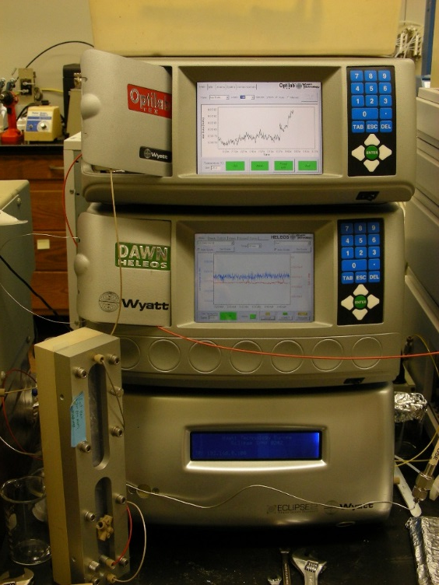
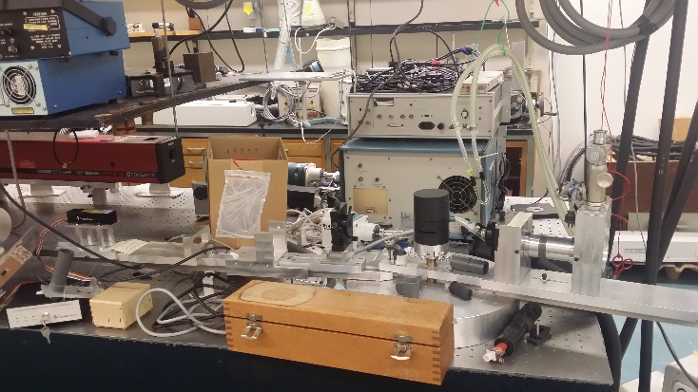
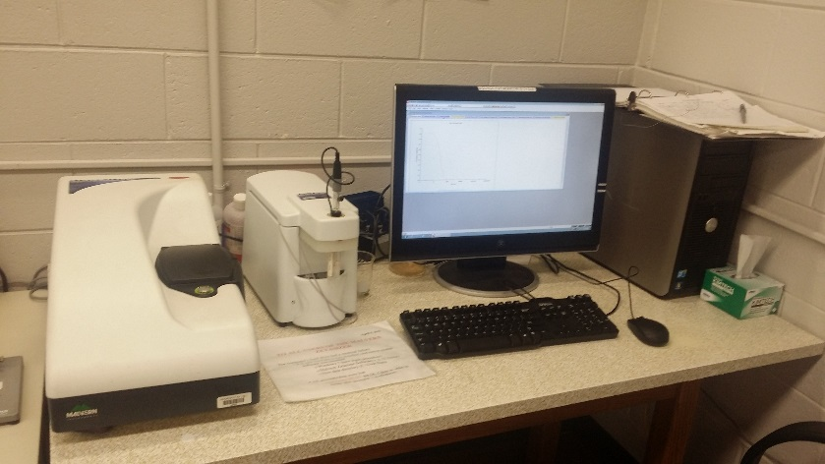
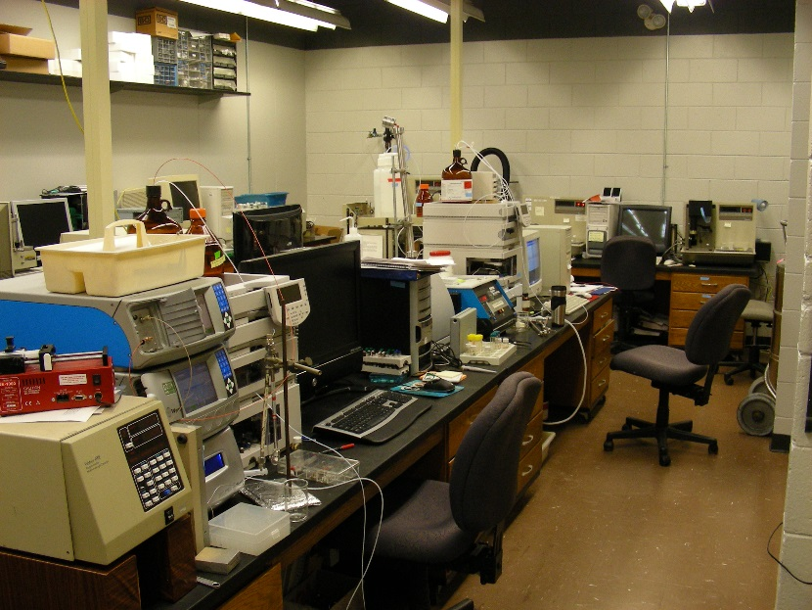
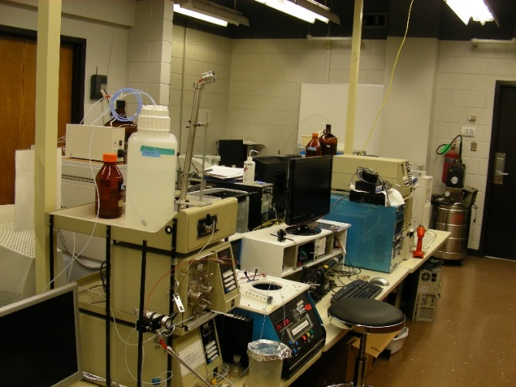

Slide 7
DLS, PCR, QUELS
Dynamic Light Scattering
Photon Correlation Spectroscopy
Quasi Elastic Light Scattering
  Measure Brownian Motion
  Obtain Diffusion Rate
  Calculate Hydrodynamic Radius

Slide 8
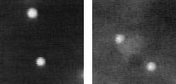
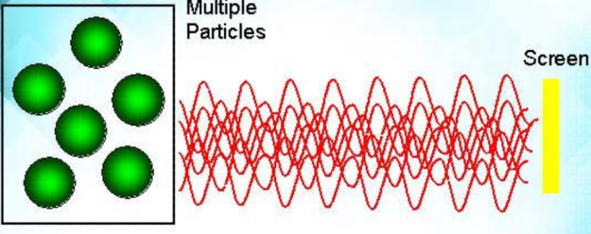
How DLS Works
Speckle Pattern
The animated image of Brownian motion of 2mm particles in water is data taken in the Weitz lab at Harvard
Notes:
In dynamic light scattering, the speed at which the particles are diffusing due to Brownian motion is measured. This is done by measuring the rate at which the intensity of the scattered light fluctuates when detected using a suitable optical arrangement. How do these fluctuations in the intensity of scattered light arise?
Imagine if a cuvette, containing particles which are stationary, is illuminated by a laser and a frosted glass screen is used to view the sample cell. A classical speckle pattern would be seen The speckle pattern will be stationary both in speckle size and position because the whole system is stationary. The dark spaces are where the phase additions of the scattered light are mutually destructive and cancel each other out (A). The bright blobs of light in the speckle pattern are where the light scattered from the particles arrives with the same phase and interfere constructively to form a bright patch (B).

Slide 9
What is translational diffusion ?
Diffusion of molecules ---- Brownian Motion
Rotational diffusion: no signal change
Translational diffusion: signal change

Slide 10
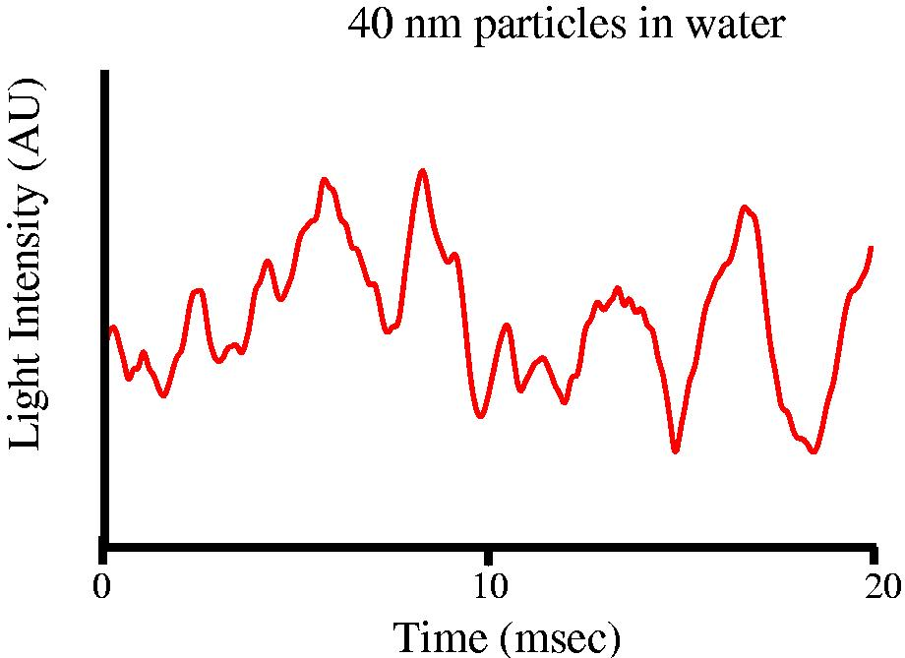
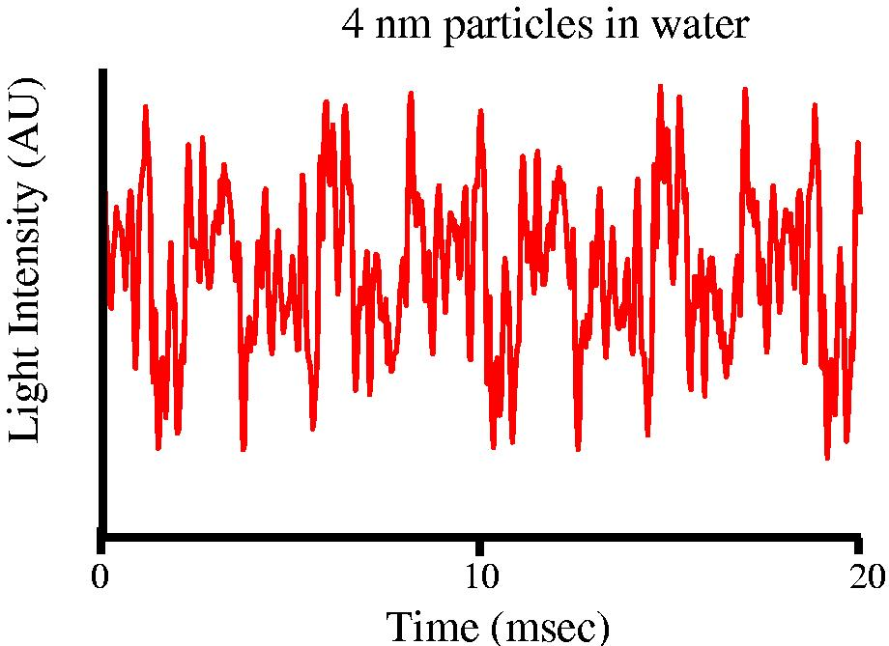
Intensity Fluctuations
Rate of Particle Diffusion is related to size
Notes:
Particles with a large physical dimension (radius) diffuse more slowly through a solvent, while small particles diffuse more quickly. Intensity fluctuations seen through time are therefore slower for large particles.
The mass of the particles has almost no influence on the rate of particle diffusion, and may safely be ignored.

Slide 11
How does a Correlator Work
Notes:
A correlator is basically a signal comparator. It is designed to measure the degree of similarity between two signals, or one signal with itself at varying time intervals.
If the intensity of a signal is compared with itself at a particular point in time and a time much later, then for a randomly fluctuating signal it is obvious that the intensities are not
going to be related in any way, i.e. there will be no correlation between the two signals . Knowledge of the initial signal intensity will not allow the signal intensity at time t = infinity to be predicted. This will be true of any random process such as diffusion.
However, if the intensity of signal at time = t is compared to the intensity a very small time later (t+δt), there will be a strong relationship or correlation between the intensities of two signals. The two signals are strongly or well correlated.
If the signal, derived from a random process such as Brownian motion, at t is compared to the signal at t+2δt, there will still be a reasonable comparison or correlation between
the two signals, but it will not be as good as the comparison at t and t+δt.
The correlation is reducing with time.
The period of time δt is usually very small, maybe nanoseconds or microseconds and is called the sample time of the correlator. t = ∞ maybe of the order of a millisecond or
tens of milliseconds.
If the signal intensity at t is compared with itself then there is perfect correlation as the signals are identical. Perfect correlation is indicated by unity (1.00) and no correlation is indicated by zero (0.00).
If the signals at t+2δt, t+3δt, t+4δt etc. are compared with the signal at t, the correlation of a signal arriving from a random source will decrease with time until at some time, effectively t = ∞, there will be no correlation.
If the particles are large the signal will be changing slowly and the correlation will persist for a long time (figure 6). If the particles are small and moving rapidly then correlation
will reduce more quickly (figure 7).
Viewing the correlogram from a measurement can give a lot of information about the sample. The time at which the correlation starts to significantly decay is an indication of
the mean size of the sample. The steeper the line, the more monodisperse the sample is.
Conversely, the more extended the decay becomes, the greater the sample polydispersity.

Slide 12
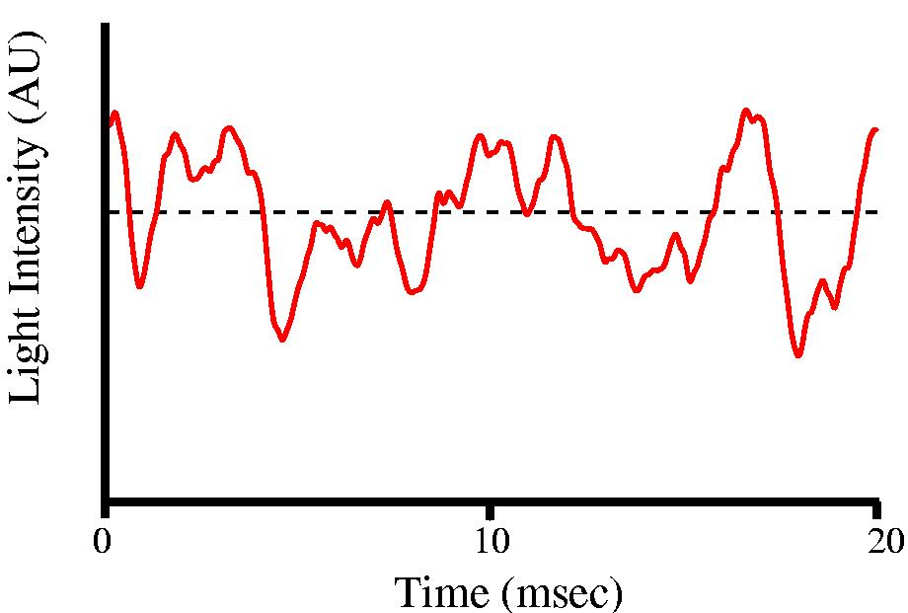
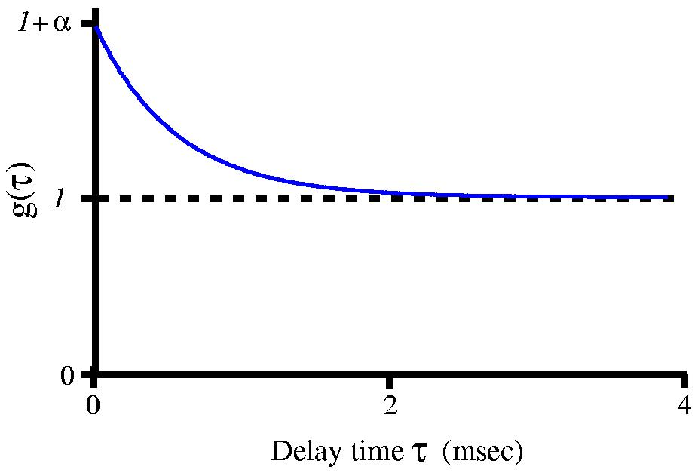
Measure Timescale of Diffusion:
Autocorrelation Function
Notes:
The autocorrelation function plots the average overall change in intensity with time, for a given time interval.

Slide 13
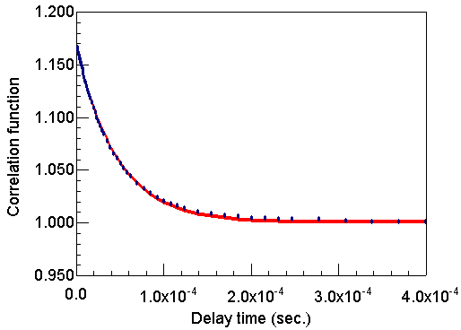
What Is A Correlogram?
Notes:
For a collection of solution particles illuminated by a monochromatic light source, the scattering intensity measured by a detector will be dependent upon the relative positions of the particles within the scattering volume. For particles moving under the influence of Brownian motion, the measured scattering intensity will fluctuate with time. Across long time intervals, the intensity trace will appear to be representative of random fluctuations about a mean value. When viewed on a much smaller time scale however, it becomes evident that the intensity trace is in fact not random, but rather composed of a series of continuous data points. This absence of discontinuity is a consequence of the physical confinement of the particles to be in a position very near to the position occupied a very short time earlier. In other words, on short time scales, the particles have had insufficient time to move very far from their initial positions, and as such, the intensity signals are very similar. The rate that the signal changes depends on the rate of change of position of particles, with large particles leading to slow fluctuations and small particles leading to fast fluctuations.

Slide 14
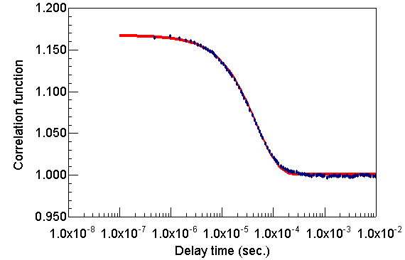
Form of the Autocorrelation Function
Linear time axis
Log time axis
R_{h} = 9nm (latex spheres)
Notes:
For a sample with only one diffusion time, the autocorrelation function may be shown to be:
For a sample containing a single species undergoing translational diffusion (Brownian motion), the autocorrelation function is a simple exponential with time constant κ. The graphs above show DLS data from a mono-disperse sample of r_{h} = 9 nm latex spheres in water (the linear and log graphs are displaying the same data). The line is a fit to a single exponential time constant.
Key Ideas:
For a single species undergoing translational diffusion, the autocorrelation function is a simple exponential.
The time constant of the exponential is a measure of how quickly the light intensity changes.

Slide 15
Typical Correlation Curves
Notes:
In dynamic light scattering instrumentation, the correlation summations are performed using an integrated digital correlator. Examples of correlation curves measured for two sub-micron particles are given in Figure 3. For the smaller and hence faster diffusing protein, the measured correlation curve has decayed to baseline within 100 μs, while the larger and slower diffusing silicon dioxide particle requires nearly 1000 μs before correlation in the signal is completely lost.

Slide 16
The Correlation Function..
G(τ) = A [ 1 + B exp (-2Γτ)]
A = the baseline of the correlation function
B = intercept of the correlation function.
Γ = Dq²
D = translational diffusion coefficient
q = (4π n / λ_{o}) sin (θ/2)
n = refractive index of dispersant
λ_{o} = wavelength of the laser
θ = scattering angle.
Notes:
In dynamic light scattering, all of the information regarding the motion or diffusion of the particles in the solution is embodied within the measured correlation curve. For a large number of monodisperse particles in Brownian motion, the correlation function (given the symbol [G]) is an exponential decaying function of the correlator time delay τ :

Slide 17
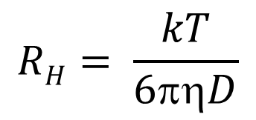
The Hydrodynamic Radius
The Stokes-Einstein Equation
$$RH= \frac{kT}{6πηD}$$
k is the Boltzmann constant
T is the temperature
η is the dispersant viscosity.
Notes:
The Stokes-Einstein relation allows us to calculate the hydrodynamic radius r_{h} from the translational diffusion constant D_{T} if we know the solvent dynamic viscosity and temperature. The r_{h} so calculated is the radius that a sphere suspended in the solvent would need to be to result in the observed diffusion constant. Temperature enters directly into the equation for D_{T} , but also enters in the solvent viscosity, which may have a large temperature dependence.
A single exponential or Cumulant fit of the correlation curve is the fitting procedure recommended by the International Standards Organization (ISO). The hydrodynamic size extracted using this method is an average value, weighted by the particle scattering intensity. Because of the intensity weighting, the Cumulant size is defined as the Z or intensity average.

Slide 18
Hydrodynamic Radius
Theoretical Examples
Rh
Rh
+
H₂O
_
H₂O
+
H₂O
+
H₂O
H₂O

Slide 19

What affects translational diffusion?
D_{T} ∝ 1/R
D_{T} ∝ 1/η
Small particles move faster
Viscous solvent slows it down.
…and if concentration too high, ‘viscosity effects’
D_{T} ∝ 1/f_{s}
Asphericity slows it down
D_{T} ∝ T
D_{T} ∝ 1/f_{h}
Rh encompasses all of these factors
High temperature
speeds it up
Attached solvent and/or interparticle interactions create drag
Notes:
Note that Interparticle Drag, Asphericity, and Size are all rolled into a single term (R_{h}) in the Stokes-Einstein relation. There is no direct method to distill these parameters out of DLS data individually.

Slide 20




Cumulant Analysis
Exponential fit:
Expanded to account for polydispersity or band broadening:
Cumulant Approach:
Notes:
In the light scattering area, the term polydispersity is derived from the polydispersity index, a parameter calculated from a Cumulants analysis of the DLS measured intensity autocorrelation function. In the Cumulants analysis, a single particle size is assumed and a single exponential fit is applied to the autocorrelation function. The autocorrelation function, along with the exponential fitting expression, is shown below, where I is the scattering intensity, t is the initial time, τ is the delay time, A is the amplitude or intercept of the correlation function, B is the baseline, D is the diffusion coefficient, q is the scattering vector, λo is the vacuum laser wavelength, ñ is the medium refractive index, θ is the scattering angle, k is the Boltzmann constant, T is the absolute temperature, η is the viscosity of the medium, and RH is the hydrodynamic radius.
In the Cumulants approach, the exponential fitting expression is expanded to account for polydispersity or peak broadening effects
The expression is then linearized and the data fit to the form shown below, where the D subscript notation is used to indicate diameter. The 1st Cumulant or moment (a1) is used to calculate the intensity weighted Z average mean size and the 2nd moment (a2) is used to calculate a parameter defined as the polydispersity index (PdI).

Slide 21
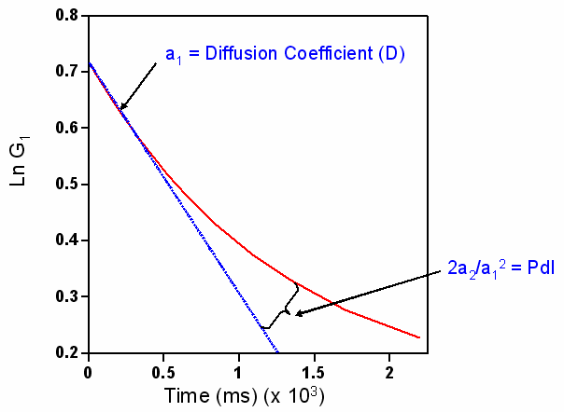
Cumulant Analysis..
Notes:
Note from the figure below that the 1st moment is proportional to the initial slope of the linear form of the correlogram and the
2nd moment is related to the inflection point at which log G deviates from linearity.

Slide 22
Polydispersity Index
0 to 0.05 - Monodisperse
0.05 to 0.08 - Nearly Monodisperse
0.08 to 0.7 - Mid Range Polydispersity
Greater than 0.7 – Very Polydisperse; Probably not suited for DLS Measurements

Slide 23
Intensity Size distributions
Notes:
While the Cumulant algorithm and the Z average are useful for describing general solution characteristics, for multimodal solutions consisting of multiple particle size groups, the Z average can be misleading. For multimodal solutions, it is more appropriate to fit the correlation curve to a multiple exponential form, using common algorithms such as CONTIN or Non Negative Lease Squares (NNLS).

Slide 24
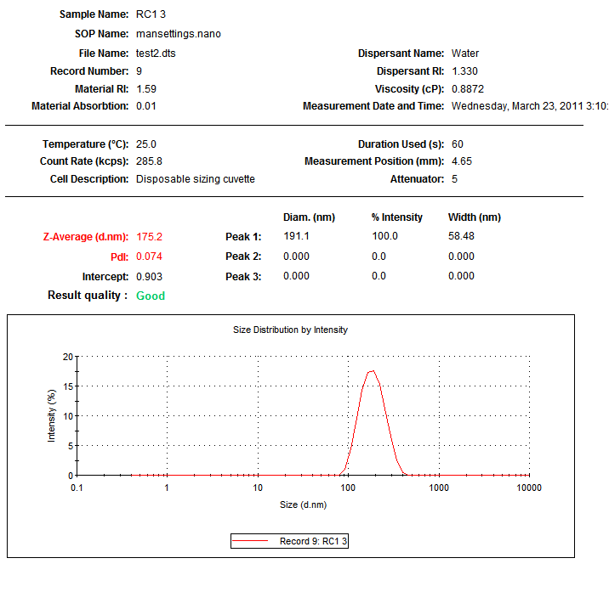
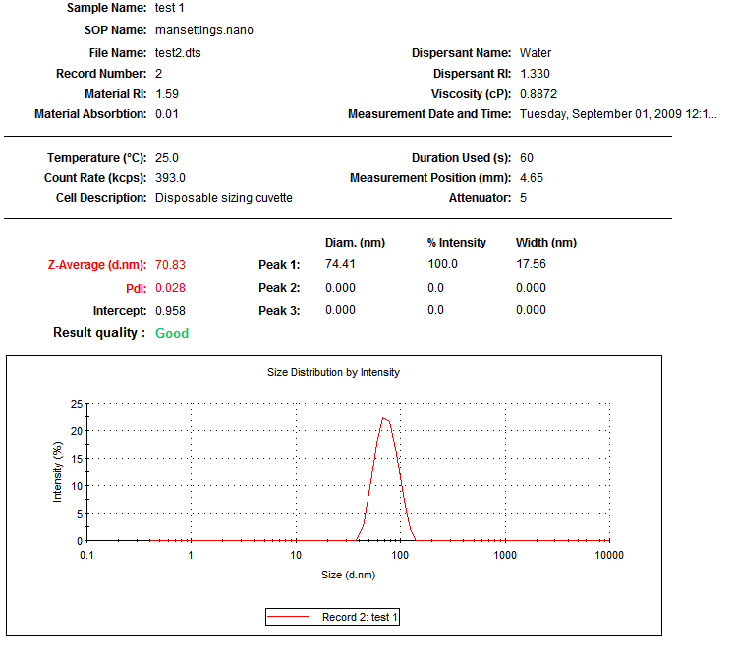
Typical Results

Slide 25
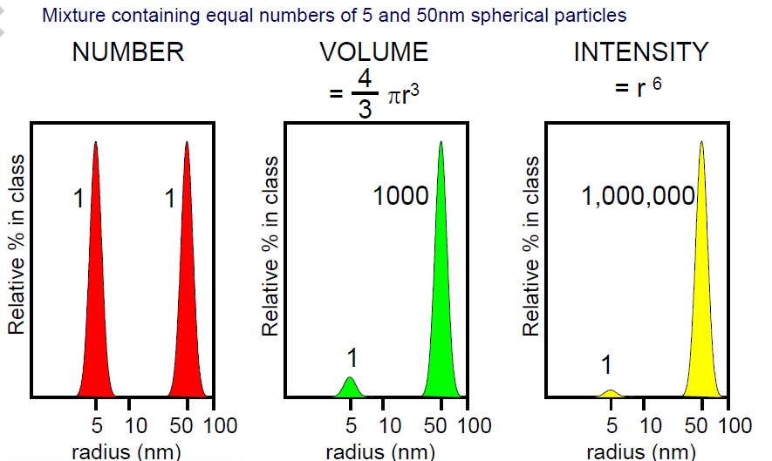
Intensity, Volume, Number distributions
Notes:
The area under each peak in the DLS measured intensity particle size distribution is proportional to the relative scattering intensity of each particle family. Since the scattering intensity is proportional to the square of the molecular weight (or R6), the intensity distribution will tend to be skewed towards larger particle sizes.
While this behavior is expected, it can lead to some confusion with new users of DLS instrumentation.
A transformation of the intensity to a volume or mass distribution can be accomplished using Mie theory, wherein the optical properties of the analyte are used to normalize the effects of the R6 dependence of the scattering intensity. The assumptions required for the transformation are:
1) The particles can be modeled as spheres.
2) All particles have an equivalent and homogeneous density.
3) There is no error in the intensity particle size distribution.
4) The optical properties of the particles are known, i.e. the real & imaginary components of the refractive index
For many applications, the first 2 assumptions are reasonable. The third assumption however, will always fail, due to the ill-posed nature of the correlogram fitting in the DLS technique. In other words, regardless of how monodisperse the sample is, the DLS measured distribution will always have a small degree of inherent polydispersity, i.e. you’ll never be able to achieve a single band distribution as one might achieve using TEM measurements. As such, the volume transform should not be used to report particle size, but rather to report mass composition.

Slide 26
Using MIE theory for volume, number distribution calculations
The particles can be modeled as spheres.
All particles have an equivalent and homogeneous density.
There is no error in the intensity particle size distribution.
The optical properties of the particles are known, i.e. the real & imaginary components of the refractive index

Slide 27
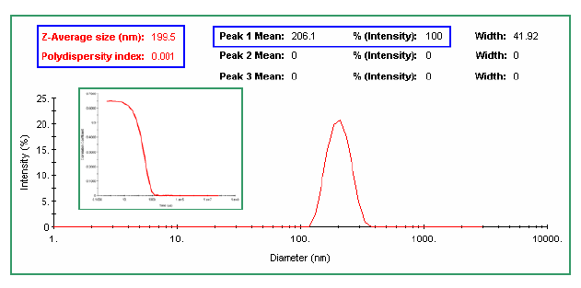
Ideal Results
Cumulant & multimodal distribution results are consistent

Slide 28
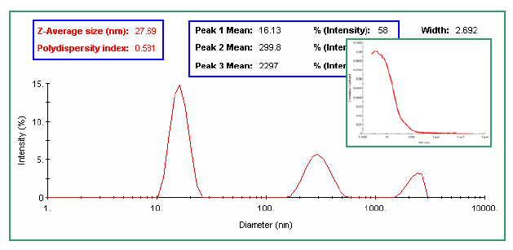
Typical Results
Cumulant & multimodal distribution results are NOT consistent

Slide 29
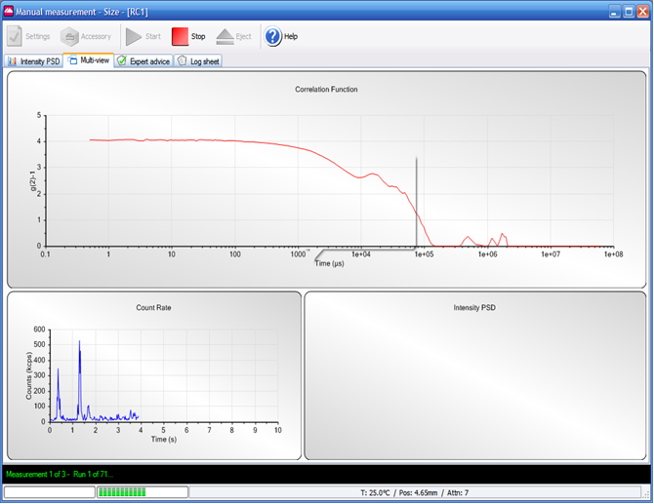
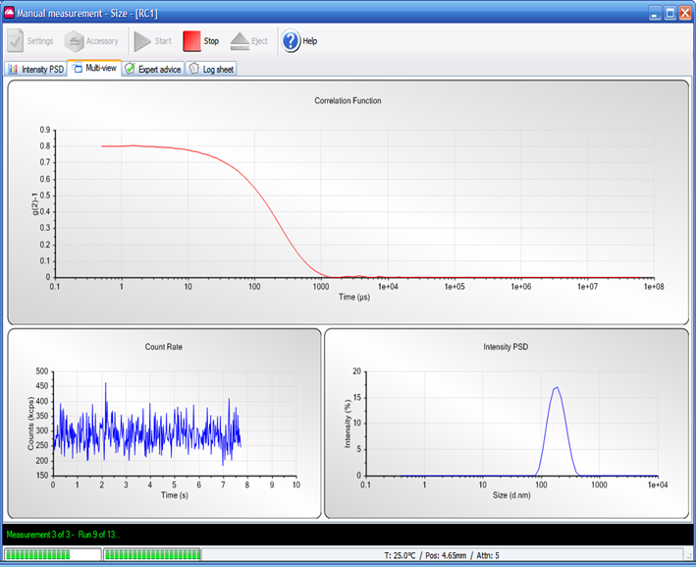
Good ----Bad

Slide 30
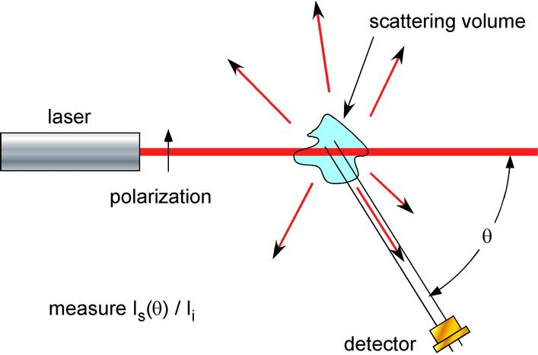
What is Static light scattering (SLS)?
In the lab…
Notes:
Notes: In the laboratory we can control the conditions to retrieve detailed information about the light scattering. We can choose the wavelength (λ), polarization, and intensity (I_{i}) of the incident light. The size of the laser beam and the field of view of the detector define a scattering volume. We can detect the scattered light (I_{s}) from this volume as a function of angle (θ) and polarization.
With such exquisite control of the experimental parameters, we can use light scattering to retrieve fundamental physical properties of the scattering medium.

Slide 31
What can SLS measure?
For a solute in solution, light scattering can determine:
Molar mass, M
Size, r_{g}
Second virial coefficient, A₂
Translational diffusion coefficient, D_{T}
  - Can be used to calculate r_{h}
Notes:
Notes: With the controlled parameters of an experiment, it is possible with a light scattering measurement to retrieve the molar mass (M), size (r_{g}), second virial coefficient (A₂), and translational diffusion coefficient (D_{T}) of a solute in solution. One of the tremendous advantages of light scattering over almost any other method is that these properties can be measured in solution in a non-invasive manner.
Depending on the type of experiment, a light scattering measurement retrieves different aspects of the above-mentioned properties. For example, in an unfractionated sample, or a batch measurement, the measured molar mass is averaged over the weight distribution of the sample, while the size determined in such a measurement is an average over the radius squared. For fractionated samples, the unaveraged mass and size distributions can be obtained, and from this, information about conformation can be determined.
Also, the first three quantities, M, r_{g}, and A₂, are measured via a technique called either classical, static, or Rayleigh scattering. In this technique, the time scale of the measurement is long compared to rapid fluctuations in scattered intensity due to molecular motion. These fluctuations are hence averaged out. The focus of today’s lecture is Rayleigh scattering. It is also possible to measure the fast (nanosecond) fluctuations of the scattered intensity in a technique known as dynamic light scattering, photon correlation spectroscopy, or Quasi-Elastic Light Scattering (QELS). This type of measurement determines the translational diffusion coefficient for the solute, which is sometimes converted to an effective hydrodynamic radius (r_{h}) based on the assumption that the solute is a sphere.

Slide 32
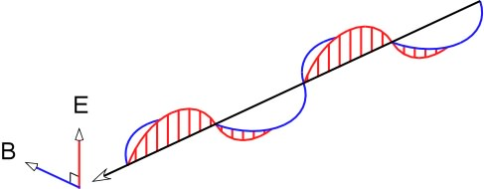
Light and its properties
Light is an oscillating wave of electric and magnetic fields
Polarization: direction
of electric field oscillation
Intensity:
Notes:
Notes: Between 1864 and 1873, James Clerk Maxwell developed the theoretical description of electricity and magnetism. His results lead to the marvelous prediction that light is electromagnetic radiation propagating through free space in the form of orthogonal, oscillating electric and magnetic fields.
Maxwell’s description explains many of the important properties of light. For example, light is often linearly polarized. The polarization of the light is determined by the direction of oscillation of the electric field. Scattered and reflected light is often polarized, as can be readily tested with a pair of polaroid sunglasses. Look at the variation of the intensity of skylight or light reflected from a puddle as you rotate the glasses!
The measurable quantity of light is the intensity, which is proportional to the square of the electric field magnitude, i.e., . The intensity is a measure of the power imparted by the light on a given area.
Key Ideas:
electric field - Light consists of oscillating electric and magnetic fields. The electric field interacts more strongly with matter than the magnetic field.
linear polarization - The direction of oscillation of the electric field.
intensity - The observable quantity of the light, i.e., the power imparted by the light on a given area. The intensity is proportional to the square magnitude of the electric field.

Slide 33
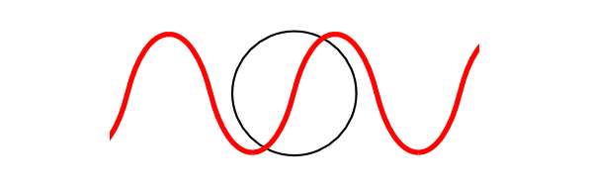
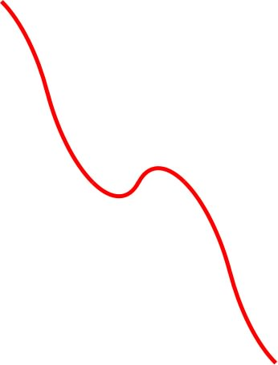
How does light scatter?
When light interacts with matter, it causes charges to polarize.
The oscillating charges
radiate light.
How much the charges move,
and hence how much light radiates, depends upon the matter’s polarizability.
Notes:
Notes: There is a simple explanation for light scattering. The oscillating electric field of the light partially separates positive and negative charges in the particle, with the amount of separation determined by the polarizability of the particle. Note that the interactions of the magnetic field of the light with matter are in general much weaker than the electric field; The magnetic field will thus be ignored from here on.
In the limit where the wavelength of the light is much longer than the physical dimensions of the particle, the separated charges produce a dipole field. The oscillating electric field creates an oscillating dipole in the particle, which can then reradiate the light, much like an antenna for a radio station. The amount of light scattered in this fashion is typically quite small – only a fraction of a percent of the incident light. Also, the light is scattered predominately in the plane perpendicular to the polarization.
Note that this picture of the particle oscillating as a dipole is only valid in the Rayleigh-Gans-Debye (RGD) limit. In this limit, the wavelength of the light is much longer than the physical dimensions of the particle. The RGD limit will be discussed in more detail later.
Key Ideas:
polarizable - positive and negative charges in a material can be partially separated to produce a dipole field. The easier it is to separate the charges, the more polarizable the material. The polarizability of a material is related to its index of refraction (to be discussed later).

Slide 34
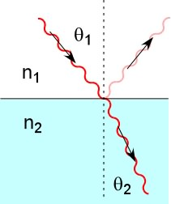
Index of refraction n
The polarizability of a material is directly
related to its index of refraction n.
The index of refraction is a measure of
the velocity of light in a material.
e.g., speed of light
For solutes, the polarizability is expressed as the specific
refractive index increment, dn/dc.
Notes:
Notes: In a continuous medium, light interacts with the matter as it propagates. The degree to which the light is affected by the matter is quantified by the index of refraction. The index of refraction is used to describe several interesting properties of light. For example, the net field in a continuous medium travels with a speed slower than the speed of light in vacuum: .
When light traverses an interface between two media with different indices of refraction, some of the light can be reflected from the interface, while the path of the remaining light can be refracted. Snell’s law relates the indices of refraction to the angle of refraction: .
The index of refraction is directly related to the polarizability of a material, and thus the amount of light it will scatter. Typically, a related quantity, dn/dc, i.e., the change in index of refraction with concentration, is measured for a solute to determine the amount of light a given amount of solute will scatter. dn/dc is known as the specific refractive index increment.
Key Ideas:
index of refraction - A term describing the interaction of light with matter, directly related to the polarizability of a material.
refraction - The bending of light at an interface between media with different indices of refraction.
reflection - At an interface, some of the light does not propagate through the interface, but is reflected back.

Slide 35
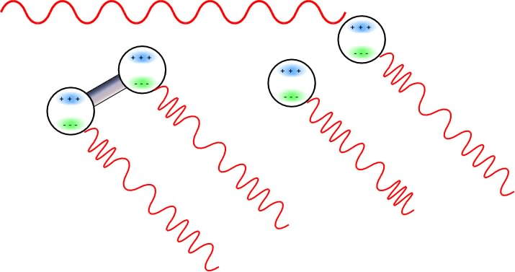
How SLS measures M
coherent:
incoherent:
I
∝
E
+
E
2
=
4
E
2
I
∝
E
2
+
E
2
=
2
E
2
total
total
⎛
dn
2
⎞
I
∝
Mc
⎜
⎟
scattered
⎝
dc
⎠
Notes:
Notes: Consider a system of scattering centers, each with the same scattering properties and mass. If two scattering centers are connected into one larger particle, then there is a definite phase relation between the light scattered from each scattering center because the particle is moving together as whole. Therefore, the scattered light adds coherently.
If the two scattering centers are separated, the Brownian motion of each center is different. Therefore, the phase relationship changes with time between the scattered light from each center, and the scattered light averages over time to add incoherently.
The difference between coherent and incoherent addition of the fields leads to an observed scattering intensity that is proportional to the mass of the system. If the specific refractive index increment (dn/dc) and concentration of a solute are known, the measured light scattering directly determines the molar mass.
Key Ideas:
Brownian motion - The random motion present in any liquid or gas due to the thermal motion of the particles. The Brownian motion can scramble the phase of the scattered light.
Molar Mass – is determined from the intensity of the scattered light.

Slide 36
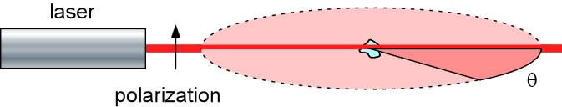
Isotropic scattering
For particles much smaller than the wavelength of the incident
light ( <10 nm for λ = 690 nm), the amount of radiation scattered
into each angle is the same in the plane perpendicular to the
polarization.
Notes:
Notes: For a particle much smaller than the wavelength of the incident light, the scatterer can be viewed as a point source of scattered radiation. There will be no measurable angular variation in the light in the plane defined perpendicular to the polarization axis.
It is interesting to note that the intensity of the scattered light does vary for angles out of the plane, even for isotropic scatterers. This is part of the explanation for the polarization of skylight.
Key Ideas:
isotropic scatterer - An isotropic scatterer scatters radiation equally into all angles in the plane perpendicular to the polarization. For a wavelength of 690 nm, particles with physical dimensions less than 10 nm are isotropic scatters.

Slide 37
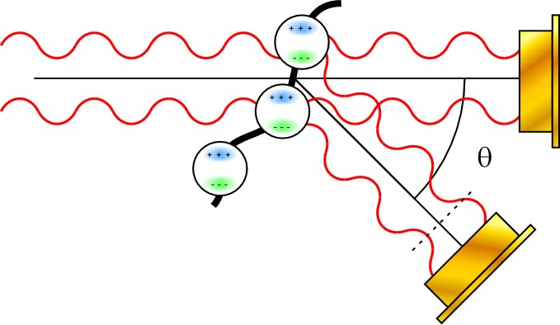
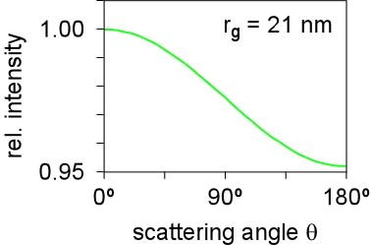
Angular dependence of light scattering
detector at 0°
scattered light
in phase
detector at θ, scattered light
out-of-phase
Intramolecular interference leads to a
reduction in scattering intensity as the
scattering angle increases.
Notes:
Notes: As particle sizes increase above 10 nm for 690 nm light, effects due to intramolecular interference lead to a variation of the scattering signal with angle in the plane perpendicular to the polarization. At zero degrees there is no attenuation (destructive interference) of the scattering intensity, but the attenuation increases with angle.
The mathematical relationship describing the variation in intensity, i.e., the form factor P(θ), depends on the size of the particle, the wavelength of the light λ, and the observation angle θ. Therefore, size information can be retrieved from the angular dependence of the scattering intensity alone. No information of the concentration or dn/dc of the solute is necessary to determine the size.
For low angles (<20 degrees for particles up to a few hundred nanometers in size), the scattering intensity decreases by at most a few percent due to intramolecular interference effects. However, it is very difficult to make measurements at low angles because of stray light. If measurements are made at multiple angles, the effects of intramolecular interference can be accounted for, and it is possible to retrieve size information!
Key Ideas:
form factor P(θ) - The mathematical relationship describing the angular variation of the scattered intensity as a function of particle size. Also called the particle scattering function.

Slide 38
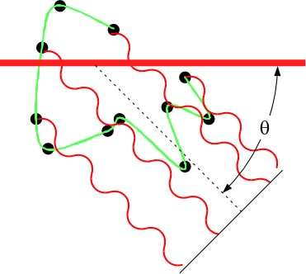
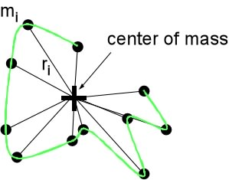
How SLS measures r_{g}
To calculate the angular distribution
of scattered light, integrate over
phase shifts from extended particle.
Integrating over extended particle
involves integrating over mass
distribution.
Notes:
Notes: How does size information come from the angular variation? An extended particle can be viewed as having many isotropic scattering centers. To calculate the total amount of light scattered into each angle, it is necessary to integrate over the contributions of each of these scattering centers. In particular, it is necessary to integrate over the phase shifts from each scattering center to determine the degree of destructive interference.
Integrating over each scattering center introduces a term in the final result that is an integration over the mass distribution of the extended particle. This term is called the root mean square radius, r_{g}. It is the mass distribution about the center of mass, weighted by the square of the distance from the center of mass.
The mean square radius is often called the “radius of gyration”. This terminology is somewhat misleading, since it implies that the measured value corresponds to the mass distribution for spinning about an axis. However, r_{g} is actually the mass distribution about a point.
Key Ideas
root mean square radius r_{g} - A measure of the size of the particle, related to the mass distribution of the particle. Sometimes called the rms radius or the radius of gyration.

Slide 39
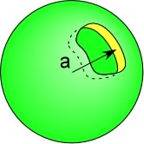
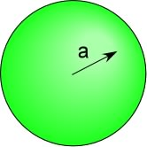
Interpretation of r_{g}
hollow sphere:
solid sphere:
Notes:
Notes: If the shape (sphere, random coil, rigid rod, etc.) is known, then the root mean square (rms) radius can be used to compute the “conventional” radii or dimensions. For example:
for a uniform density sphere with a radius r:
for a hollow sphere with a radius r:
for a random coil polymer with average end to end length L:
for a rigid rod with length L:

Slide 40
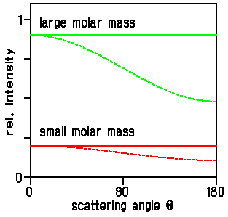
Molar mass and radius
r_{g} < 10 nm
isotropic scatterer
r_{g} > 10 nm
Notes:
Notes: For a particle much smaller than the wavelength of the incident light, less than 10nm for 690nm wavelength light, there will be no measurable angular variation of the light in the plane defined perpendicular to the polarization axis. For particles this small we can no longer accurately determine the radius. However, it is still possible to determine the molar mass of the particle down to several hundred Daltons.

Slide 41
Basic SLS principles
Principle 1
The amount of light scattered is directly proportional to the product of the polymer molar mass and concentration.
Principle 2
The angular variation of the scattered light is directly related to the size of the molecule.
Notes:
Notes: Principle 1 as stated above is true for polymer homologs that differ only by molar mass.
In general, the light scattering intensity of a polymer is proportional to a) the molar mass of the polymer,
b) the concentration of the polymer, and
c) the square of dn/dc.
Therefore to determine the molar mass of a polymer one must know the light scattering intensity (measured with a DAWN or a miniDAWN), the concentration of the polymer, and the specific refractive index increment (dn/dc) of the polymer.
Special procedures must be taken if the sample absorbs or if the sample fluoresces with excitation at the wavelength of the laser.
Principle 2: Since the angular dependence of the scattering depends only upon the rms radius of the polymer, the rms radius can be determined without knowing the concentration or the dn/dc value of the polymer.
See Physical Chemistry: with Applications to the Life Science, Eisenberg, D. & Crothers, D., The Benjamin/Cummings Pub. Co.,1979 for a relatively simple derivation of light scattering equations.

Slide 42
Basic SLS equation
In the Rayleigh-Gans-Debye limit, the two light scattering
principles are embodied in the equation:
This equation also contains a correction due to concentration c. The correction is due to coherent intermolecular scattering, and contains information on the second virial coefficient.
Notes:
Notes: The Rayleigh-Gans-Debye (RGD) approximation is a powerful generalization of light scattering theory that is applicable for particles much smaller than the wavelength of the light. The two conditions that must hold for the RGD approximation are:
1. The polymer must be effectively invisible in the solvent, i.e., ⏐m - 1⏐ << 1, where m = n/n₀ is the ratio of the refractive index of the polymer to the refractive index of the solvent.
2. The polymer does not disturb the phase of the laser light:
[ (4πr n₀) / λ₀ ] ⏐m - 1⏐ sin(θ/2) << 1,
where r is the polymer radius and λ₀ is the laser wavelength in vacuum. The second condition is equivalent to the size of the particle being much smaller than the wavelength.
Consider an example: Polystyrene (PS) in toluene. n = 1.59, n₀ = 1.497
therefore ⏐m - 1⏐ = ⏐1.06 - 1⏐ = 0.06 << 1
If laser wavelength = 690 nm, and polymer radius is 50 nm, then for the 90 degree detector: [ (4πr n₀)/ λ₀ ] ⏐m - 1⏐ sin(θ/2) = 0.058 << 1
Approximations are valid at 690 nm for PS in toluene up to at least a molar mass of 5,000,000 daltons! The approximation is better at lower angles
Lastly, the concentration correction is based on the assumption that particles interact at a single point

Slide 43
Definition of terms 1
R(θ) – excess (i.e., from the solute alone) Rayleigh ratio.
The ratio of the scattered and incident light intensity,
corrected for size of scattering volume and distance
from scattering volume.
n₀ – solvent refractive index
N_{A} – Avogadro’s number
λ₀ – vacuum wavelength of incident light
dn/dc - spec. refractive index increment
K* .
M – molar mass
Notes:
Notes: Notice the dn/dc term in K*.
1) This is the specific refractive index increment for the polymer in solution. It is a measure of the change in the refractive index of the polymer solution as the polymer concentration changes.
2) The dn/dc for the polymer in the solvent must be known to compute a molar mass by light scattering!
3) Since the dn/dc term is squared, a 10% error in the dn/dc value will result in a 20% error in the computed molar mass in a microbatch or batch type experiment in which the concentration of the polymer is determined independently. In SEC/MALS using an on-line refractive index detector to determine the polymer concentration the computed molar mass depends only upon dn/dc to the first order. A 10% error in dn/dc will result in a 10% error in the molar mass.
Key Ideas
excess Rayleigh ratio R(θ) - The actual measurement of scattered light depends on several factors, including the angle, distance from detector to scattering volume, incident light intensity, and the volume of sample illuminated. The excess Rayleigh ratio is a ratio of the scattered and incident light intensities that takes into account these different factors. It is called the excess ratio because it is for scattered light in excess of scattered light from the solvent, i.e., for the solute alone. The excess Rayleigh ratio is measured by the DAWN or the miniDAWN instruments.

Slide 44
Definition of terms 2
c – solute concentration (g/ml)
P(θ) – form factor or “scattering function”. P(θ) relates the angular variation in scattering intensity to the mean square radius r_{g} of the particle.
The larger r_{g}, the larger the angular variation.
(Note that P(0°) = 1)
A₂ – second virial coefficient, a measure of solute-solvent interaction. Positive for a “good” solvent.
Notes:
Notes: The second virial coefficient (A₂) is a thermodynamic term which is indicative of the solvent - solute interaction.
If A₂ > 0: The solvent is a “good” solvent for the given polymer.
If A₂ = 0: The solvent is known as a “theta solvent” or an “ideal” solvent. The solvent is neither a good solvent nor a poor solvent. In a theta solvent the radius of a random coil polymer is the same as the radius would be for the pure polymer.
If A₂ < 0: The solvent is a poor solvent for the given polymer. The polymer may precipitate from the solution if A₂ is a large negative number.
Note that the value of the particle scattering function (or form factor), P(θ), at zero degrees is 1.0. In other words, at zero scattering angle there is no attenuation of the scattering intensity due to the size of the polymer.
Key Ideas
second virial coefficient A₂ - The second term in the virial expansion of the osmotic pressure. A₂ is a measure of the solute-solvent interaction. A₂ enters the light scattering equation as a correction factor for concentration effects; at higher concentrations, coherent intermolecular scattering affects the scattered light intensity.

Slide 45
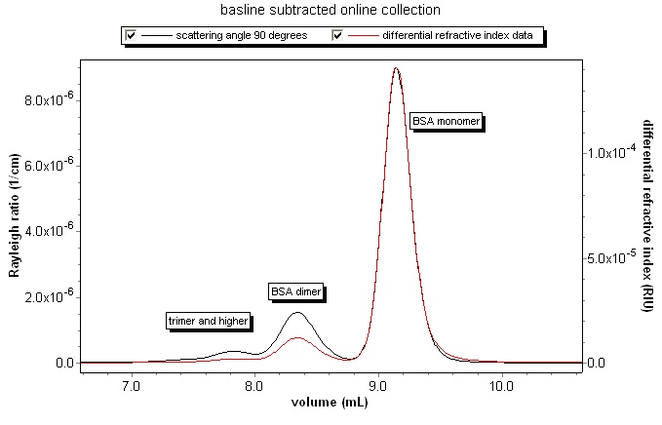
Online Data Collection
Record Rayleigh ratio at varying angle measuring concentration.
Notes:
Notes: In an online experiment, a fractionated sample is passed in series through the light scattering instrument and a concentration detector, such as an RI or UV instrument. Since the concentration is measured directly, it is not necessary to know the concentration of the sample beforehand. Note in the example how the relative light scattering and refractive index signals change for the BSA oligimer sequence. This is visual proof of how light scattering is proportional to the molar mass and concentration, while the concentration detector signal is proportional to just the concentration.

Slide 46
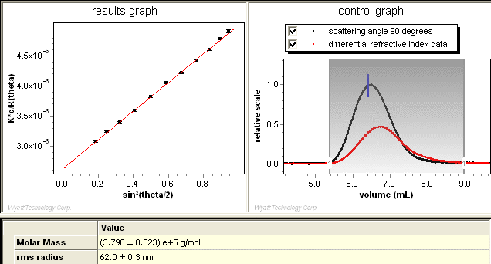
Online Data Analysis
Perform fit of angular data to retrieve M and r_{g}.
Assess quality of fit using a Debye plot.
Notes:
Notes: In an online experiment, concentrations are often low enough that the correction in the light scattering signal due to the second virial coefficient can be ignored. In this instance, the concentration is measured for each slice by a concentration detector such as an RI or UV instrument. The angular variation of the data is then fit to determine a mass and radius.
ASTRA goes one step further, in that it is possible to enter a known second virial coefficient for the sample, and the generally small correction due to the second virial coefficient can be included as well for the most accurate results.
The quality of the fit to the light scattering equation can be assessed in a Debye plot. The Debye plot shows the angular fit of the light scattering data. Problems with normalization, flow cell cleanliness, and appropriate fit degree can be determined by inspecting the Debye plot.
Key Ideas
Debye plot – A plot of the angular dependence of the light scattering signal and the fit results to the basic light scattering equation. The Debye plot is used to assess the quality of the fit to the light scattering data. For a good fit, the points overlay the fit line within their error bars, and there are no systematic deviations. A poor Debye plot can be indicative of poor normalization, dirty flow cell, or an inappropriate fit model or fit degree.

Slide 47
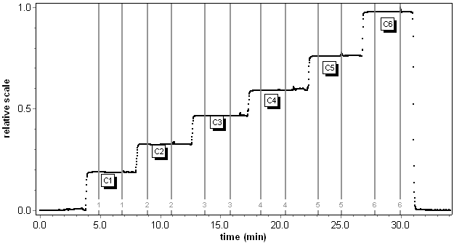
Batch Data Collection
excess scattering
solvent scattering
+ detector offset
Record Rayleigh ratio varying
- angle (up to18 angles )
- concentration (multiple injections of known c).
Notes:
Notes: In a batch collection the sample is inserted into the instrument in a vial, such as the MicroCuvette or scintillation vial, or the flow cell volume is completely filled with the sample of interest. The signal level is a plateau that corresponds to a known concentration prepared for the experiment.
The total light scattering signal in volts is the sum of three components:
1. The signal from the photodiodes themselves. This voltage is called the dark voltage offset because it is the signal present when the laser is off (the flow cell is dark). The signal can be either positive or negative.
2. The signal from the solvent (buffer, mobile phase). This is typically called solvent offset. This signal is positive.
3. The signal from the polymer in excess of the signal from the solvent or the dark voltage offset. This is typically called the excess scattering or excess polymer scattering. This signal is positive.
Note that the operation of setting the baseline in the ASTRA software is performed to obtain the excess polymer scattering from the total light scattering signal.

Slide 48
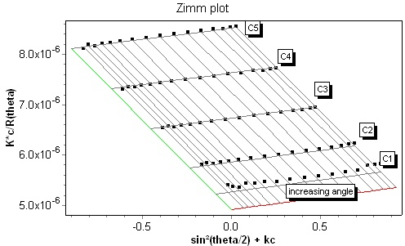

Batch Data Analysis
Perform global fit of data to light scattering equation to retrieve M, r_{g}, and A₂.
Assess quality of fit using a Zimm plot.
Notes:
Notes: The point of a batch experiment is to determine the molar mass, rms radius, and second virial coefficient of the sample. To do so, it is necessary to measure the light scattering signal as a function of angle and concentration. The Wyatt Technology instruments naturally measure the light scattering as a function of angle. To vary the concentration, multiple samples can be prepared at known concentrations.
The angular and concentration dependent light scattering data are fit to the basic light scattering equation. This global fit is different than the Zimm plot analysis traditionally used to analyze batch data. The global fit takes the data as a whole, and no extrapolation to zero angle or concentration is necessary.
The quality of the fit can be assessed via a Zimm plot. This type of plot is a two-dimensional slice of a three-dimensional data set. The global fit results are presented as a grid, and the data as points. For a good fit, the measured data points fall within uncertainty on the grid, and there are no systematic deviations. The above Zimm plot shows an instance where the concentration for the C1 data is probably not accurately known. The global fit highlights this immediately.
Key Ideas
Zimm plot – Traditionally, a plot combining concentration and angular light scattering data used to determine molar mass, rms radius, and second virial coefficient via extrapolation to zero angle and zero concentration. For the global fit method, the Zimm plot is merely a visual means to assess the quality of the fit.

Slide 49
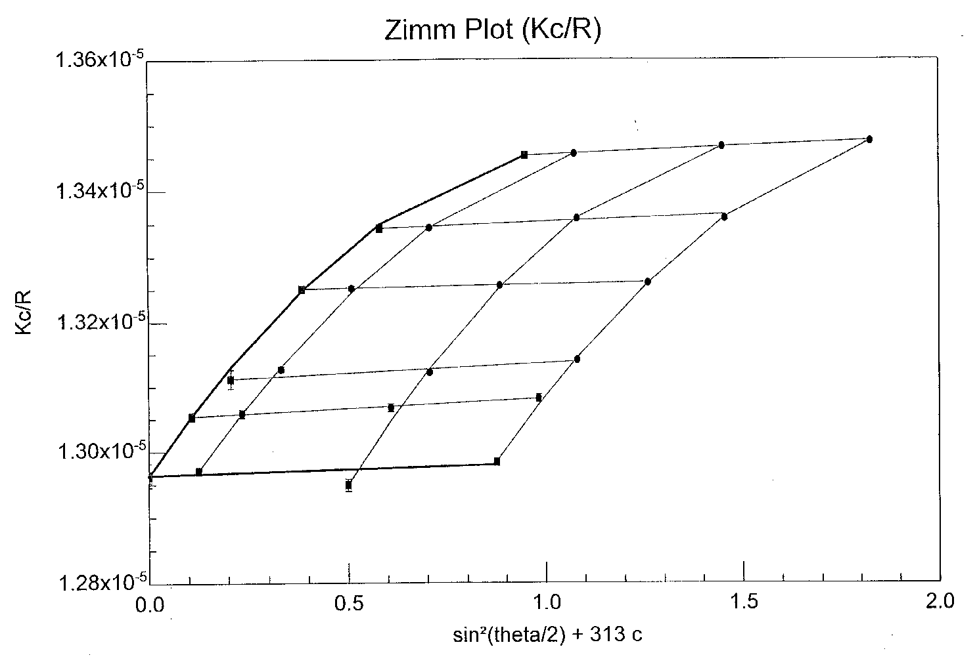
Zimm Plot of a Protein
Molar Mass (MM) : (7.714±0.01)e+4 g/mol (0.16%)
RMS Radius (Rz) : 2.6±2.2 nm (84%)
2nd virial coefficient : (1.413±0.06)e-4 mol mL/g² (3%)
Aqueous microbatch Zimm Plot of BSA monomer
Notes:
Notes: The point of a batch experiment is to determine the molar mass, rms radius, and second virial coefficient of the sample. To do so, it is necessary to measure the light scattering signal as a function of angle and concentration. The Wyatt Technology instruments naturally measure the light scattering as a function of angle. To vary the concentration, multiple samples can be prepared at known concentrations.
The angular and concentration dependent light scattering data are fit to the basic light scattering equation. This global fit is different than the Zimm plot analysis traditionally used to analyze batch data. The global fit takes the data as a whole, and no extrapolation to zero angle or concentration is necessary.
The quality of the fit can be assessed via a Zimm plot. This type of plot is a two-dimensional slice of a three-dimensional data set. The global fit results are presented as a grid, and the data as points. For a good fit, the measured data points fall within uncertainty on the grid, and there are no systematic deviations. The above Zimm plot shows an instance where the concentration for the C1 data is probably not accurately known. The global fit highlights this immediately.
Key Ideas
Zimm plot – Traditionally, a plot combining concentration and angular light scattering data used to determine molar mass, rms radius, and second virial coefficient via extrapolation to zero angle and zero concentration. For the global fit method, the Zimm plot is merely a visual means to assess the quality of the fit.

Slide 50
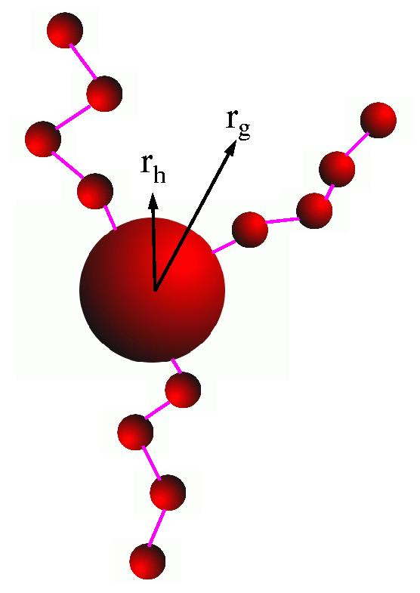
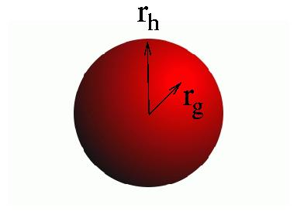
Conformation: r_{h} vs. r_{g}
3-arm star polymer
solid sphere
Notes:
Notes: By comparing the hydrodynamic radius r_{h} measured by QELS to the rms radius r_{g} measured by static multi-angle light scattering, we may learn about the compactness of a molecule. For compact objects, the mass is close in to the center of mass. The rms radius is smaller than the hydrodynamic radius for such objects. For example, for a solid sphere of radius a, the rms radius is r_{g} = 0.77a and the hydrodynamic radius is r_{h} = 1.0a . The ratio of r_{g} to r_{h} is ρ= 0.77. For an extended object, such as a star polymer, the rms radius r_{g} is strongly influenced by the outlying masses but the hydrodynamic radius r_{h} is less strongly influenced. The ratio of r_{g} to r_{h} increases as the object becomes less compact, and is about rho = 1.4 for a star polymer with three arms.
The expected ratio of r_{g} to r_{h} has been tabulated in the following references:
"Information on Polydispersity and Branching from Combined Quasi-Elastic and Integrated Scattering", W. Burchard, M. Schmidt, and W.H. Stockmayer, Macromolecules 1980, 13, 1265-1272
Light Scattering in Biochemistry, ISBN 0-85186-486-4, Edited by S.E. Harding, D.B. Sattelle, and V.A. Bloomfield, The Royal Society of London 1992, Chapter 14.
"Relationship between the Hydrodynamic Radius and the Radius of Gyration of a Polymer in Solution", Chong Meng Kok and Alfred Rudin, Makromol. Chem., Rapid Commun. 2, 655-659 (1981)
Key Ideas:
By comparing r_{g} to r_{h} we may learn about the compactness of a molecule and so gain information concerning the molecular conformation.

Slide 51
Questions?

